Slide 1
CH 3
Political Environment of Business

Slide 2
POLITICAL SYSTEM INCLUDES
Set of institutions (parliament, State assembly)
Political organizations
Intertest groups (Election commission)
A political system shows some level of stability in social relations & it is usually effective when supported by a legitimate consensus of people who live under it

Slide 3
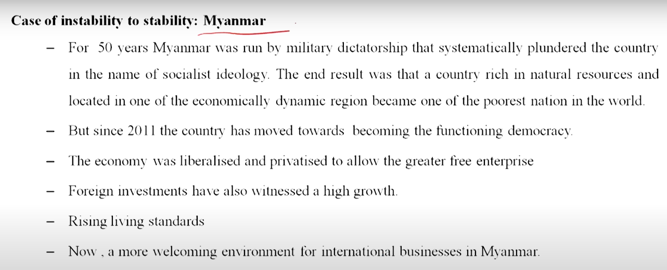
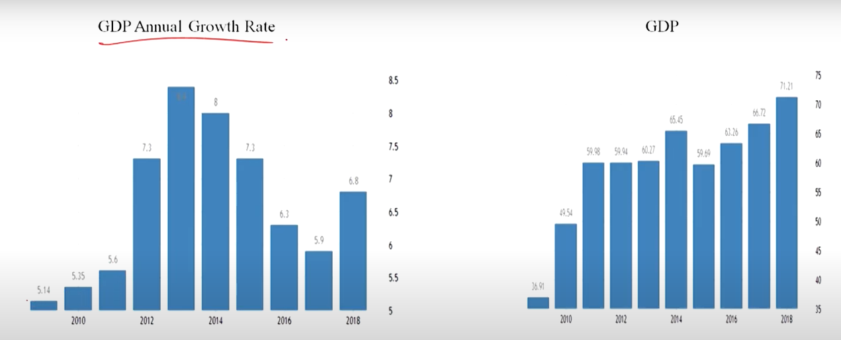

Slide 4
IMPORTANCE OF POLITICAL ENVIRONMENT
Politics play an important role in shaping business worldwide
The political LEADERSHIP in each country CONTROLS whether how the international business will occur in that country
Managers need to know how to interact between business and government and to know how to react to interests conflict

Slide 5
THE POLITICAL ENVIRONMENT INCLUDES
All laws,
Government agencies, and
Lobbying groups that influence or restrict individuals or organizations in the society.

Slide 6
THE POLITICAL ENVIRONMENT INCLUDES FACTORS SUCH AS
The characteristics and
Policies of the political parties,
The nature of the constitution
Government system, and
The government environment encompassing the socioeconomic
Business policies and
Regulations.
These factors may vary considerably between different nations, between different provinces of the same nation, and also over time.

Slide 7
FACTORS RELATED TO POLITICAL ENVIRONMENT
Individualism vs. Collectivism
Political beliefs/Ideology
  The political spectrum: Democracy and Totalitarianism/absolutism/authoritarianism
Trends in Political System
Political risk

Slide 8
INDIVIDUALISM VS. COLLECTIVISM
What is better for the country?
  Guaranteeing individual freedom for economic self-interest or
  Giving importance to collective goals?
Individualism: the primacy of the rights and role of the individual (United States)
  Individualism is a belief that everyone needs to look after themselves and support themselves
  Countries with an individualistic orientation encourage businesses to support the good of the community by promoting fair and just competition
  Follow the rule of law.
Collectivism: the primacy of the rights and the role of the community (JAPAN)
  Collectivism is a value or belief where you think of society first and what society’s needs are. You make Sacrifices for the benefit of society as a whole instead of thinking only of yourself
  Ensure that business practices benefit society

Slide 9
POLITICAL BELIEFS
The system of ideas that expresses the goals, theories or principles, and aims of socio-political programs.
It ranges from communism, and socialism to capitalism
Single, dual and multiparty system
  Single: North Korea and Mexico had an institutional revolutionary party for the last 70 years (case of Pepsi)
  Dual: U. S. & U. K.
  Multiparty: India, Canada, etc.
Most modern societies are pluralistic which asserts that both public and private groups are important in a well-functioning political system
  Different groups champion competing political ideologies
    Democrats vs. republicans in U. S.
    Democratic party vs. liberal party in Japan
    NDA vs. UPA in India

Slide 10
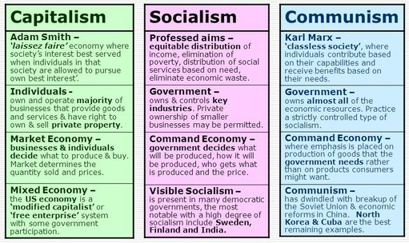

Slide 11
THE POLITICAL SCOPE
In practice, purely democratic and totalitarian governments are extremes. Rather, looking around the world, one finds there are variations to each approach.
For example democratic governments range from radical on one side (advocates of political reform) to reactionary (advocates of the return to past conditions)

Slide 12
Authoritarianism | Versus | Democracy
Power determines the law; Constitution on paper only | Rule of law | Constitutional Framework; Equality before law
Detention without charges; Few rights for accused; Imprisonment for political dissent | Civil rights | Right to a fair trail; No detention without charge; Torture prohibited
Restrictions on association; Expression and any activity contrary to any official line | Political rights | Right to vote and stand for office; Freedom of association and expression
Election of little or no choice of the candidates | Elections | Regular elections: one person/one vote; monitoring for irregularities, intimidation
Courts are an administrative arms of government | Court System | Independent judiciary; transparent process
Press controlled by the state; restricted reporting | Freedom of the press | Editorial & reporting independent from government

Slide 13
TYPES OF DEMOCRACY
Democracy is a political system that endorses the rule of law and grants the voting citizenry the power to alter the law and structure of the government to make all decisions (either directly or through representatives ) and to participate in elections that express their the decisions.
  Direct democracy: people make laws/policies themselves
      Example: Initiative: citizen petition places proposed law/constitutional amendments on the ballot, people votes yes or no (Switzerland and some states of US - Florida)
  Representative democracy: elect people to make decisions for us. Trust they will make decisions we support. Do they truly represent the citizens who elect them? Which citizen gets the “most” representation? What do we expect out of our representatives? Should they mirror the views of their constituents (be delegates) or be allowed leeway to exercise their own judgment (trustees)?
      Parliamentary (e. g. India and Australia): citizens exercise political power by electing representatives and sending them to the parliament.

Slide 14
THE ROLE & FUNCTION OF POLITICAL SYSTEM
To integrate society
The way to conduct society
The way to choose or to have a government to manage a country
For policy making
Its depends on the political ideologies

Slide 15
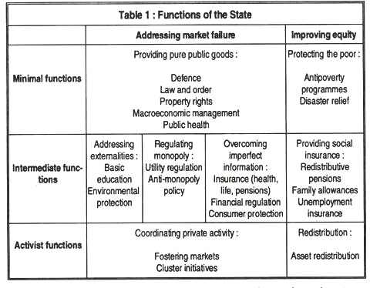

Slide 16
ECONOMIC ROLES OF GOVERNMENT
As pointed out earlier, the government plays an important role in almost every national economy of the world.
Governments normally play four important roles in an economy, viz.,
  regulation,
  promotion,
  entrepreneurship, and
  planning

Slide 17
REGULATORY ROLE
Government regulation of the economy may be broadly divided into direct controls and indirect controls.
Indirect controls are usually exercised through various fiscal and monetary incentives and disincentives or penalties. Certain activities may be encouraged or discouraged through monetary and fiscal incentives and disincentives. For instance, a high import duty may discourage imports and fiscal and monetary incentives may encourage the development of export-oriented industries.
The direct administrative or physical controls are more drastic in their effect. The distinguishing characteristic of direct controls is their discretionary nature. They can be applied selectively from firm-to-firm and industry- to-industry, at the discretion of the State.

Slide 18
PROMOTIONAL ROLE:
The promotional role played by the government is very important in developed countries as well as in developing countries.
In developing countries, where
  the infrastructural facilities for development are inadequate and
  entrepreneurial activities are scarce,
The promotional role of the government assumes special significance.
  The State will have to assume direct responsibility to build up and strengthen the necessary development infrastructures, such as power, transport, finance, marketing, institutions for training and guidance, and other promotional activities.

Slide 19
ENTREPRENEURIAL ROLE:
In many economies, the State also plays the role of an entrepreneur — establishing and operating business enterprises and bearing the risks
Since the 1980s many governments have resorted to privatization, in varying degrees, and have redefined the role of the public sector.

Slide 20
PLANNING ROLE
The importance of planning to a less developed economy was often emphasized by Jawaharlal Nehru, the chief architect of Development Planning in India.
He rightly observed: “Whatever it may be in other countries, in underdeveloped countries like ours, which have to develop fairly rapidly, the time element is important and the question is how to use our resources to the best advantage

Slide 21
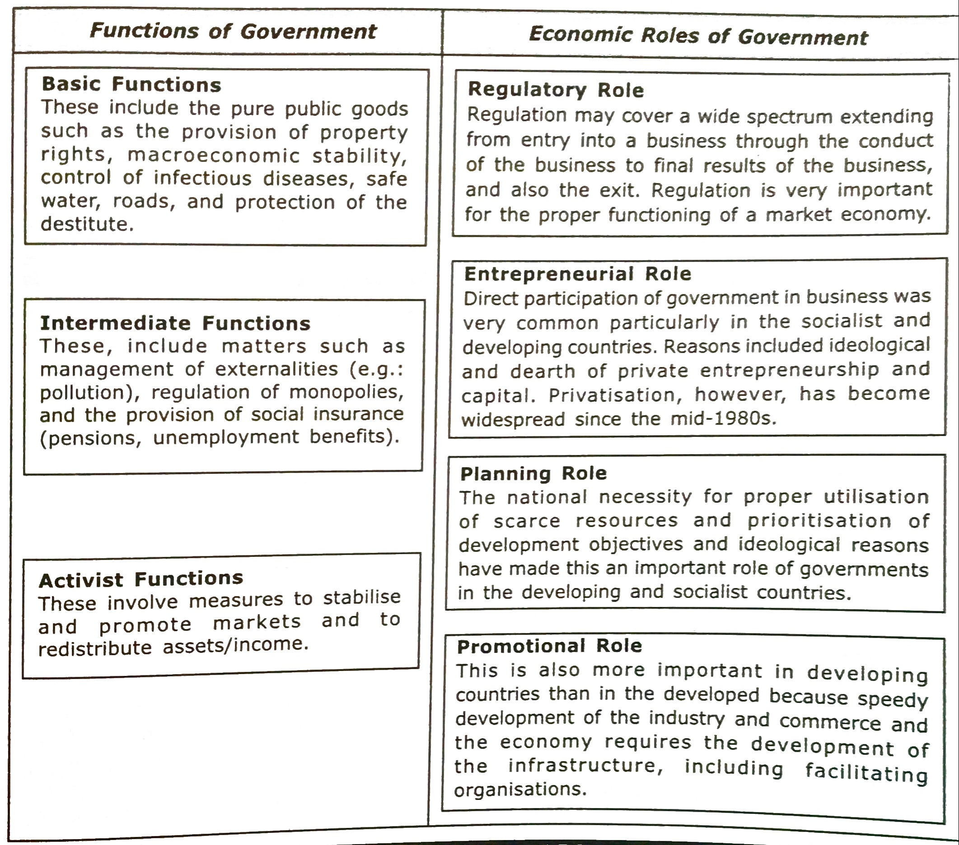

Slide 22
GOVERNMENT AND LEGAL ENVIRONMENT
Various types of Law are formed by Government
Consumer Protection Act
Environmental Law
Prohibition Law
Statuary Warning
Competition Law
Advertising law
Industrial policy
Monetary policy
Fiscal Policy
EXIM Policy

Slide 23
POLITICAL INSTITUTIONS
Legislature
Executive
Judiciary

Slide 24
LEGISLATURE
Most powerful institution
Role is to make the law
Powers
Policy making
Law making
Approval of budgets

Slide 25
EXECUTIVE
Referred to as government
Responsible for implementing the law
To shape, direct and control the business activities

Slide 26
JUDICIARY
Responsible for interpreting and applying the law
It has to look into the exercise of authority by the executives according to the general rules laid down by the legislature.
To settle legal disputes that affect business considerably.
    Disputes between employers and employees
    Disputes between two companies
    Disputes between employees

Slide 27
RELATIONSHIP BETWEEN BUSINESS AND GOVERNMENT
Responsibility
Accountability
Duty

Slide 28
RESPONSIBILITIES OF BUSINESS TOWARDS GOVERNMENT
Regular payment of taxes
Voluntary programs
  Sponsoring social welfare programs
  Environmental preservation
  Promoting education
  Assistance in drought, flood, etc.
Providing Feedback information
Government contracts
Providing service to the government through becoming a member in an advisory board

Slide 29
RESPONSIBILITIES OF GOVERNMENT TOWARDS BUSINESS
Provision of a peaceful atmosphere
Provision of a system of money and credit
  Balanced development and growth
Provision of basic infrastructure
Provision of information
To assist small-scale industries
Licensing and inspection
Protection from foreign competition

Slide 30
WHY POLITICAL ENVIRONMENT IS IMPORTANT TO MANAGERS?
managers must learn to deal with public institutions and non public institutions in addition to market forces
Managers must learn to cope with varying degrees of governmental intervention in economic decisions, depending on the countries in which a company is doing business
The political impact on business activities is relatively complex because the domestic political process is subject to various influences & managers must deal with different political process in different countries

Slide 31
STEPS TO ESTABLISH AN APPROPRIATE POLITICAL STRATEGIES
IDENTIFY THE ISSUE : What is the specific issue facing a firm –
  environmental standards, workers right, terrorism and etc.
DEFINE THE NATURE: Define the nature of the politics issue
ASSESS THE POTENTIAL POLITICAL ACTION of other companies and of special interest groups who are the parties that are affected and able to generate political pressure? What are their strategies to be?
IDENTIFY IMPORTANT INSTITUTIONS & KEY INDIVIDUALS : Legislatures, regulatory agencies, courts, important personalities
FORMULATE STRATEGIES: What are the key objective, the major alternatives, and likely effectiveness of alternative strategy
DETERMINE THE IMPACT OF IMPLEMENTATION:
SELECT: The most appropriate strategy & implement!

Slide 32
THE CONSTITUTION OF INDIA
Most significant document which is fundamental to the governance of the State.
The constitution of Indian Republic is the product of not political revolution, but of the research and deliberations of a body of eminent representatives

Slide 33
THREE PARTS OF THE CONSTITUTION
The Preamble
The Fundamental Rights
The Directive Principles of State Policy

Slide 34
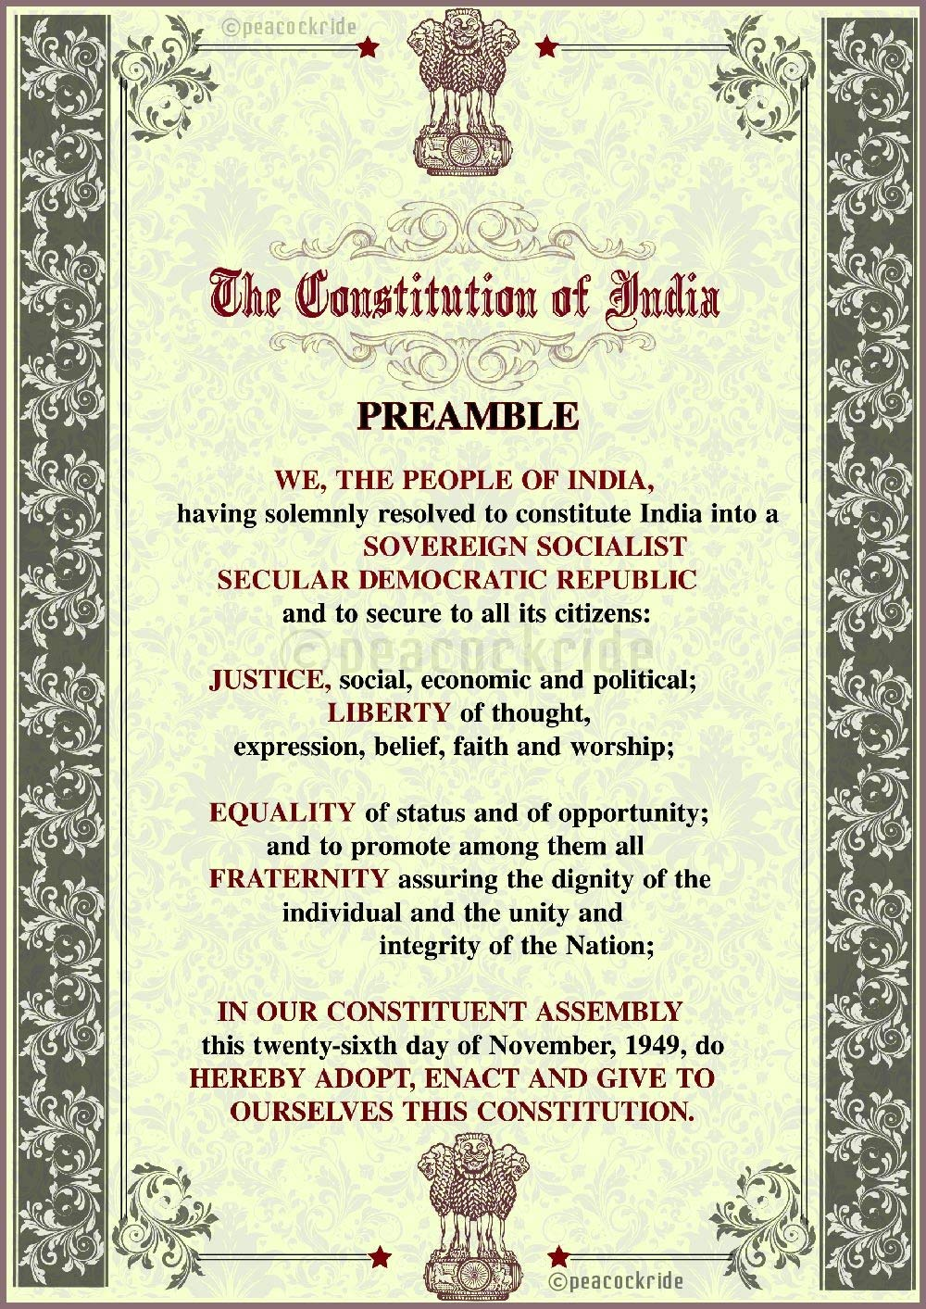
THE PREAMBLE
An introduction to the Constitution and contains its basic philosophy. It states that
“We the people of India having solemnly resolved to constitute ourselves into a Sovereign, Socialist, Secular, Democratic Republic and to secure to all citizens………..adopt, enact and give to ourselves this Constitution.

Slide 35
FUNDAMENTAL RIGHTS
Right to equality
Right to freedom
  Freedom of speech and expression
  Freedom to assemble peacefully and without arms
  Freedom to form associations or unions
  Freedom to move freely throughout the territory of India
  Freedom to reside and settle anywhere in India
  Freedom to practice any profession or to carry on trade or business
Right against exploitation
Right to freedom of religion
Right to cultural and educational freedom
Right to constitutional remedies

Slide 36
DIRECTIVE PRINCIPLES OF STATE POLICY
A unique feature of our Constitution.
Instruments of instructions to the legislature and the executive.

